Slide 1
Problem statement
Write an application to demonstrate the change in BeagleBoard CPU frequency or square wave of programmable frequency.

Slide 2
What is BeagleBone Black?
BeagleBone Black is a low-cost, community-supported development platform for developers and hobbyists. Boot Linux in under 10 seconds and get started on development in less than 5 minutes with just a single USB cable.
Processor: AM335x 1GHz ARM® Cortex-A8

Slide 3
Features
512MB DDR3 RAM
4GB 8-bit eMMC on-board flash storage
3D graphics accelerator
NEON floating-point accelerator
2x PRU 32-bit microcontrollers

Slide 4
Software Compatibility
Debian
Android
Ubuntu
Cloud9 IDE on Node.js w/ BoneScript library
plus much more

Slide 5
Connectivity
USB client for power & communications
USB host
Ethernet
HDMI
2x 46 pin headers

Slide 6
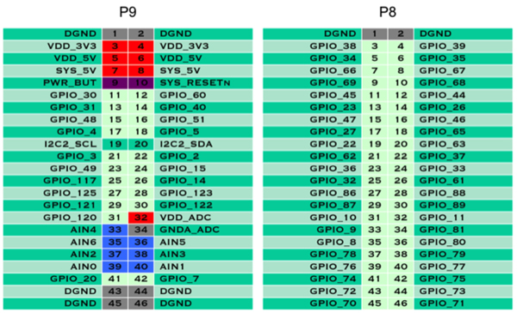
BBB GPIO layout

Slide 7
python modules
matplotlib
numpy
time
psutil
os
thread

Slide 8
matplotlib
a python 2D plotting library which produces publication quality figures in a variety of hardcopy formats and interactive environments across platforms.
For simple plotting the pyplot interface provides a MATLAB- like interface.
ion
turn interactive mode on

Slide 9
continued…
Show : display a figure
Plot : plot lines and/or markers to the axes.
xlabel : set the x-axis label of the current axis
ylabel : set the y-axis label of the current axis

Slide 10
continued…
draw : redraw the current figure
cla : clear the current axis

Slide 11
Adafruit_BBIO.PWM module
Adafruit_BBIO.PWM.start(channel , duty, freq=2000, polarity=0)
Adafruit_BBIO.PWM.set_duty_cycle(channel, duty)
Adafruit_BBIO.PWM.set_frequency(channel, duty)
Adafruit_BBIO.PWM.stop(channel)

Slide 12
Thank You

